Slide 1
CGB1201 – JAVA PROGRAMMING PROJECT REVIEW-2
Department of Computer Science and Engineering
Academic Year: 2024 – 2025 (Odd Semester)
Register Number :2303811720521045
Name :S.SANTHOSH
Year :II
Semester :III
Section :A
Date :22/11/24

Slide 2
Title of the Project
Chat application

Slide 3
Abstract
The ChatApp is a simple Java console application for private and group messaging. Users can select individuals from a list to chat privately or send messages to the entire group. The application utilizes basic Java features like lists, loops, and input validation.

Slide 4
Abstract with CO/PO Mapping
Abstract | CO | POs | PSO
The ChatApp is a simple Java console application for private and group messaging. Users can select individuals from a list to chat privately or send messages to the entire group. The application utilizes basic Java features like lists, loops, and input validation.

Slide 5
Introduction
The ChatApp is a simple Java-based console application that allows users to send private and group messages. It demonstrates basic programming concepts such as lists, loops, and input validation. This app serves as a foundation for building more advanced messaging systems with additional features.

Slide 6
Java Programming - Concepts Used
Lists and ArraysLoops
Conditional Statements (if-else)
MethodsInput Handling
ValidationSwitch Statements
Exception Handling

Slide 7
Proposed Architecture
cd
User Interface
Error handling
n
sd
Input Handling
Main controller
User management
messaging

Slide 8
Proposed Architecture - Description
User Interface:
Displays the menu and interacts with the user, allowing them to choose between private chat, group chat, or exit the program.
Main Controller:
Handles the main logic, processing user input and directing to the appropriate methods for chat functionality.
User Management:
Manages the list of users (stored in an ArrayList) and displays them for selection in chats.

Slide 9
Proposed Architecture - Description (Cont..)
Messaging:
Facilitates private and group messaging between users, simulating the core chat functions.
Input Handling and Validation:
Captures user input via Scanner and ensures the input is valid, preventing errors.
Error Handling:
Uses exception handling to manage input errors and ensure the application runs smoothly.

Slide 10
List of Modules
User Interface
ModuleMain Controller
ModuleUser Management
ModuleMessaging
ModuleInput Handling
Validation ModuleError
Handling Module

Slide 11
Module Description
User Interface Module:
Displays menus and options for the user to interact with the app. It guides the user through different actions like private or group chat.
Main Controller Module:
Controls the flow of the program based on user input. It directs the app to the correct functionality (chat options, exit).
User Management Module:
Manages the list of users available for chat. It stores users in an ArrayList for selection in private or group messaging.

Slide 12
Module Description (Cont..)
Messaging Module:
Handles the logic for sending private and group messages. It ensures that messages are directed to the right recipients.
Input Handling and Validation Module:
Captures user input and ensures it is valid. It prevents errors by validating choices and message entries.
Error Handling Module:
Manages exceptions and unexpected errors. It ensures the program continues running smoothly despite invalid input or other issues.

Slide 13
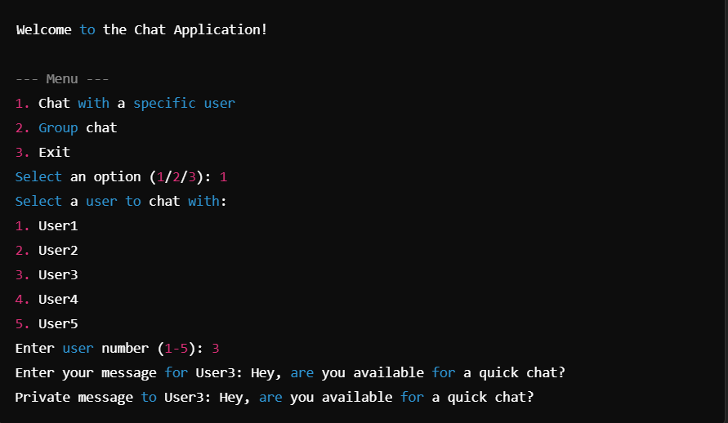
Results and Discussion

Slide 14
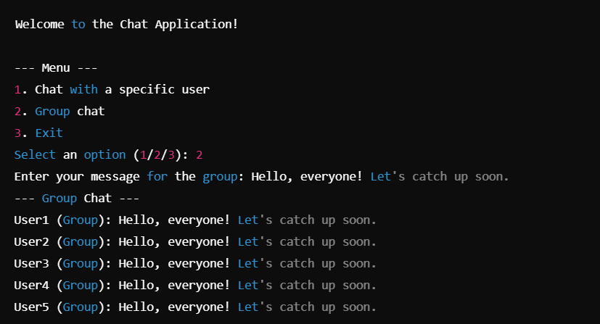
Results and Discussion (Cont..)

Slide 15
Conclusion
The ChatApp provides a simple platform for private and group messaging between users. It utilizes basic Java features like lists, loops, and input validation to ensure smooth interaction. The app handles both direct and group chats effectively, with clear user prompts and error handling. This serves as a basic foundation, with potential for future enhancements like real-time messaging or user authentication.

Slide 16
Thank You
Any queries???

